Slide 1
EECS 490 – Lecture 15 Object-Oriented Programming

Slide 2
Announcements
Project 3 due tomorrow at 8pm
Midterm Tuesday 10/31 during class time
Will be in 1109 FXB, not in this room
Covers lectures 1-12
You are allowed one 8.5x11" note sheet, double sided
Review session: Sunday 10/29 2-4pm in 1690 BBB
Mid-semester survey due Fri 11/3 at 8pm
http://survey2.eecs490.org

Slide 3
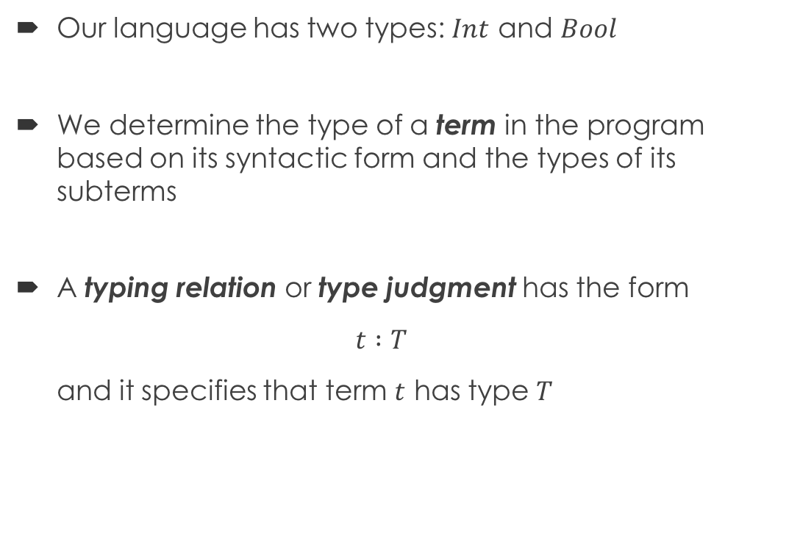
Review: Types and Type Judgments
Our language has two types: $Int$ and $Bool$
We determine the type of a term in the program based on its syntactic form and the types of its subterms
A typing relation or type judgment has the form $t :T$ and it specifies that term $t$ has type $T$

Slide 4
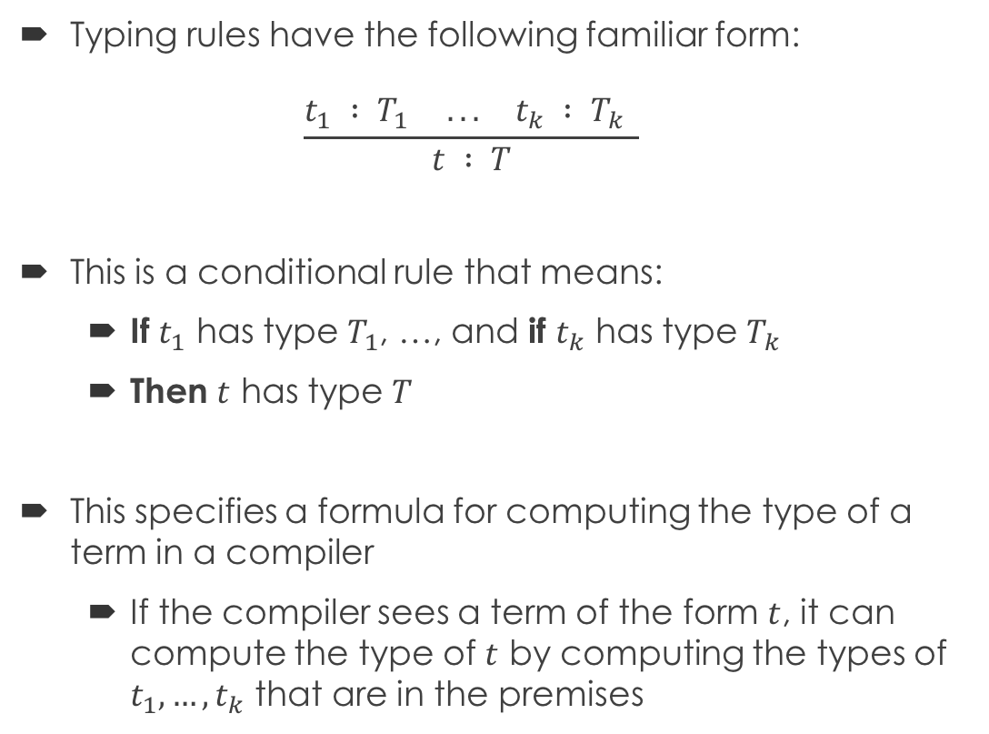
Review: Typing Rule
Typing rules have the following familiar form: $\frac{t_{1} : T_{1} ... t_{k} : T_{k} }{t : T}$
This is a conditional rule that means:
If $t_{1}$ has type $T_{1}$, …, and if $t_{k}$ has type $T_{k}$
Then $t$ has type $T$
This specifies a formula for computing the type of a term in a compiler
If the compiler sees a term of the form $t$, it can compute the type of $t$ by computing the types of $t_{1},…,t_{k}$ that are in the premises
Premise
Conclusion
Type Judgment

Slide 5
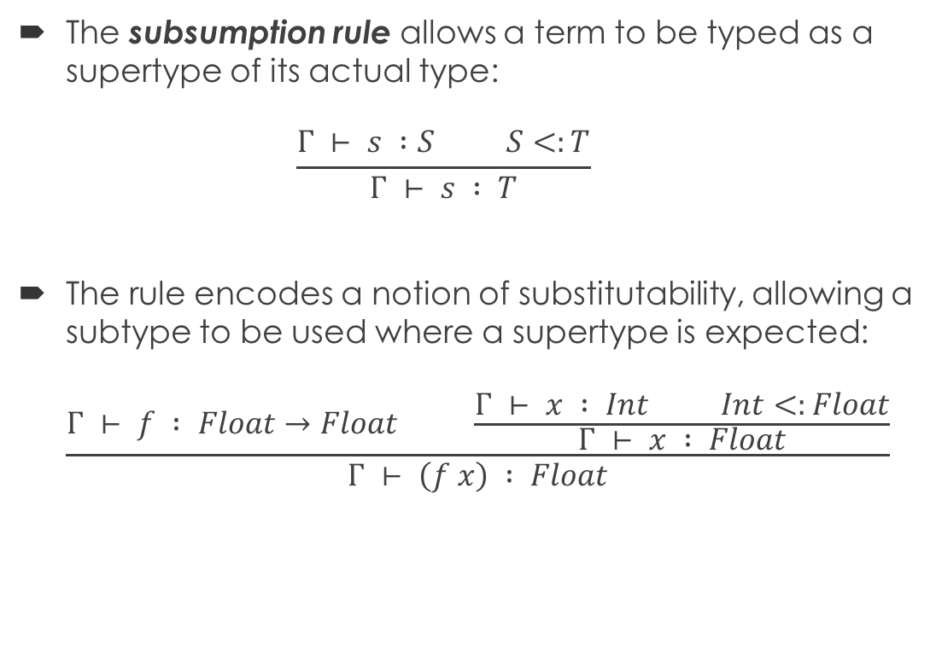
Review: Subsumption Rule
The subsumption rule allows a term to be typed as a supertype of its actual type: $\frac{Γ ⊢ s :S S<:T}{Γ ⊢ s : T}$
The rule encodes a notion of substitutability, allowing a subtype to be used where a supertype is expected: $\frac{Γ ⊢ f : Float→Float \frac{Γ ⊢ x : Int Int<:Float}{Γ ⊢ x : Float}}{Γ ⊢ \left(f x\right) : Float}$

Slide 6
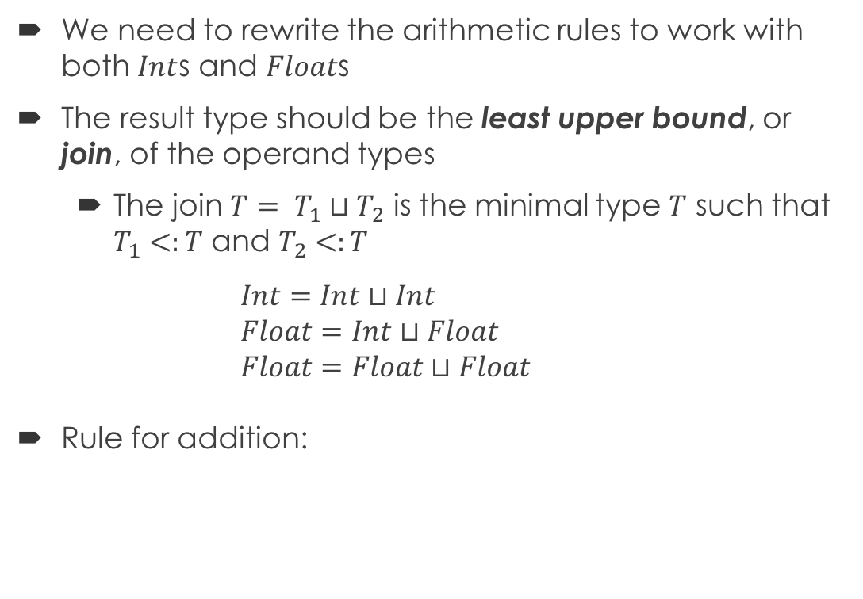
Joins
We need to rewrite the arithmetic rules to work with both $Int$s and $Float$s
The result type should be the least upper bound, or join, of the operand types
The join $T= T_{1}⊔T_{2}$ is the minimal type $T$ such that $T_{1}<:T$ and $T_{2}<:T$ $Int=Int⊔Int$ $Float=Int⊔Float$ $Float=Float⊔Float$
Rule for addition:
Require operand type to be a number
$$\frac{{Γ ⊢ t}_{1} : T_{1} {Γ ⊢ t}_{2} : T_{2} T_{1}<:Float T_{2}<:Float T= T_{1}⊔T_{2}}{Γ ⊢ \left(t_{1}+t_{2}\right) : T}$$

Slide 7
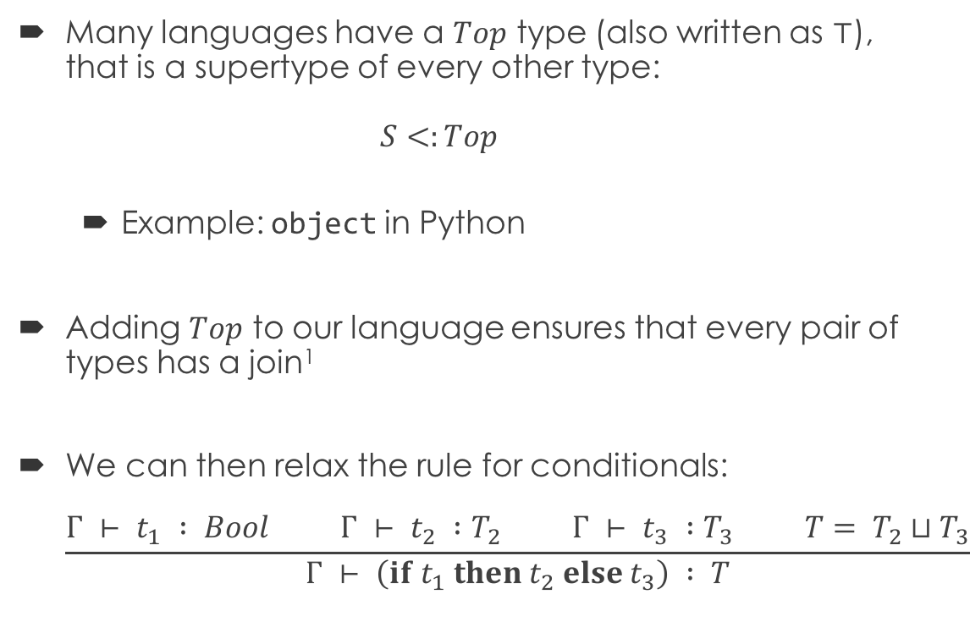
The Top Type
Many languages have a $Top$ type (also written as $⊤$), that is a supertype of every other type: $S<:Top$
Example: object in Python
Adding $Top$ to our language ensures that every pair of types has a join¹
We can then relax the rule for conditionals: $\frac{{Γ ⊢ t}_{1} : Bool {Γ ⊢ t}_{2} :T_{2} {Γ ⊢ t}_{3} :T_{3} T= T_{2}⊔T_{3}}{Γ ⊢ \left(if t_{1} then t_{2} else t_{3}\right) : T}$

Slide 8
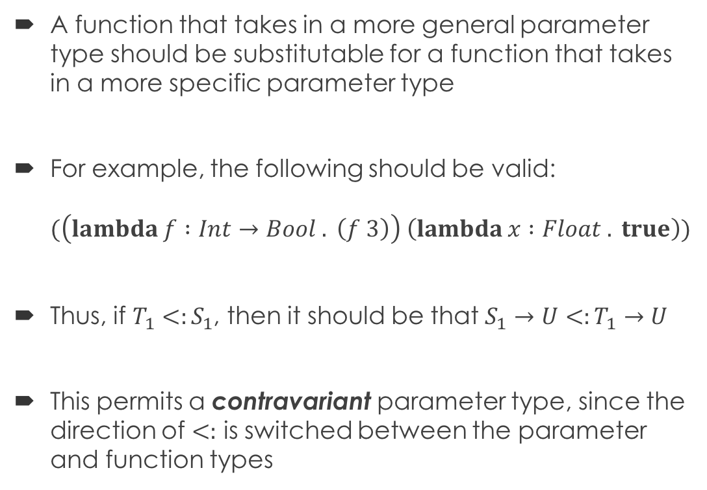
Contravariant Parameters
A function that takes in a more general parameter type should be substitutable for a function that takes in a more specific parameter type
For example, the following should be valid: $(\left(lambda f :Int→Bool . \left(f 3\right)\right) \left(lambda x :Float . true\right))$
Thus, if $T_{1}<:S_{1}$, then it should be that $S_{1}→U<:T_{1}→U$
This permits a contravariant parameter type, since the direction of $<:$ is switched between the parameter and function types

Slide 9
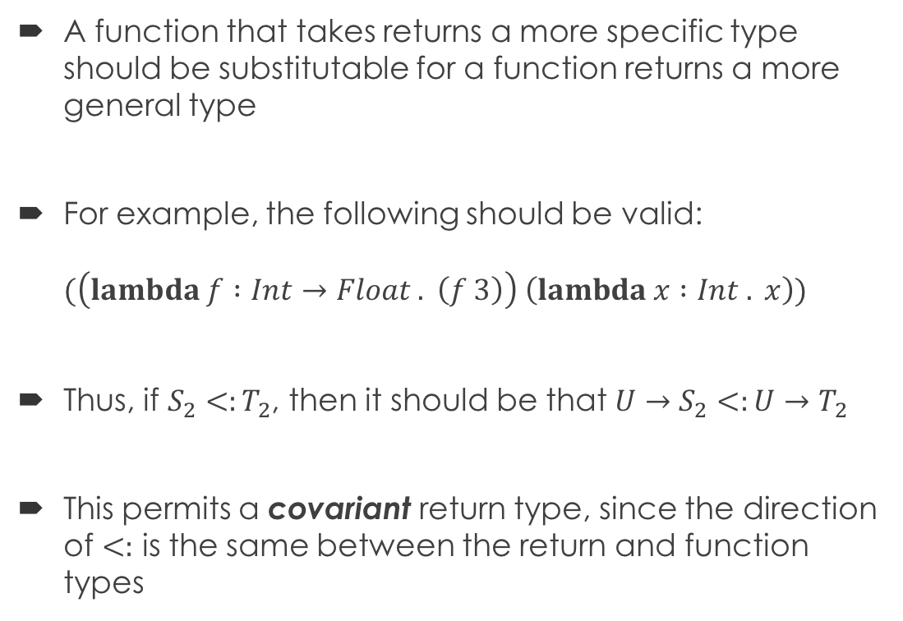
Covariant Return Types
A function that takes returns a more specific type should be substitutable for a function returns a more general type
For example, the following should be valid: $(\left(lambda f :Int→Float . \left(f 3\right)\right) \left(lambda x :Int . x\right))$
Thus, if $S_{2}<:T_{2}$, then it should be that $U→S_{2}<:U→T_{2}$
This permits a covariant return type, since the direction of $<:$ is the same between the return and function types

Slide 10
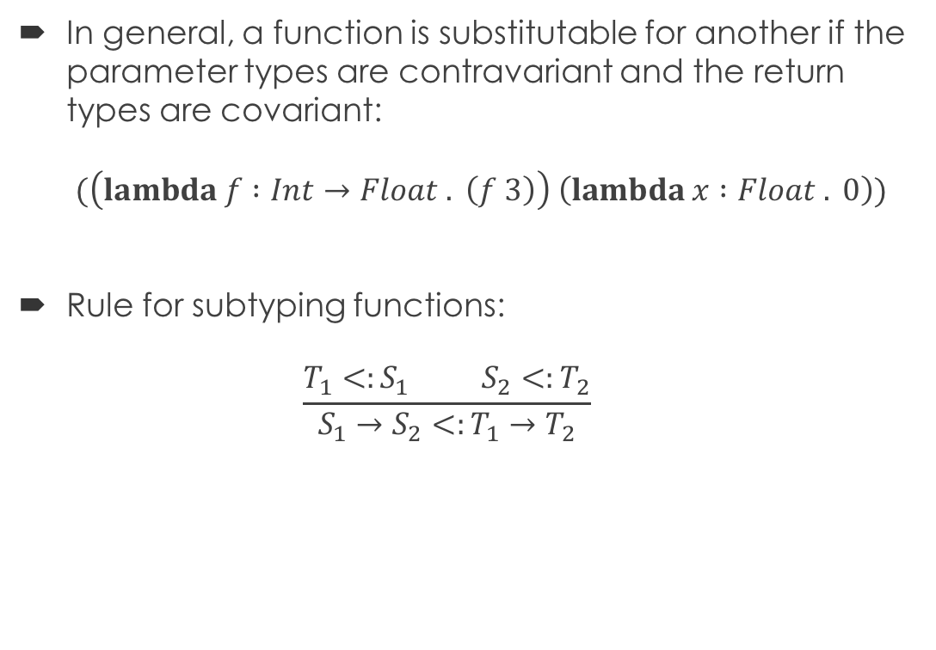
Subtyping for Functions
In general, a function is substitutable for another if the parameter types are contravariant and the return types are covariant: $(\left(lambda f :Int→Float . \left(f 3\right)\right) \left(lambda x :Float . 0\right))$
Rule for subtyping functions: $\frac{T_{1}<:S_{1} S_{2}<:T_{2}}{S_{1}→S_{2}<:T_{1}→T_{2}}$

Slide 11
Data Abstraction
Abstraction separates what something is from how it works
Abstract data types (ADTs) separate the interface of a data type from its implementation
Encapsulation is an important, though not universal, property of an ADT, binding the data the ADT represents along with the functions that operate on that data
The course notes build a hierarchy of ADTs, beginning with immutable pairs all the way up to an abstraction similar to that provided by object-oriented programming
Required reading, like the rest of the notes!

Slide 12
Message Passing
Higher-order functions can provide encapsulation in a functional ADT, allowing us to pass a message requesting a particular behavior
A dispatch function takes the appropriate action given a message
def mutable_pair(x, y): def dispatch(message, value=None): nonlocal x, y if message == 'first': return x elif message == 'second': return y elif message == 'set_first': x = value elif message == 'set_second': y = value return dispatch
>>> p = mutable_pair(3, 4) >>> p('first') 3 >>> p('second') 4 >>> p('set_first', 5) >>> p('set_second', 6) >>> p('first') 5 >>> p('second') 6

Slide 13
Dispatch Dictionaries
A dispatch dictionary stores a mapping of messages to functions that perform the specified behavior
The dispatch function now just looks up a message in the dictionary and returns the corresponding function def account(initial_balance): ... dispatch = dictionary() dispatch('setitem', 'balance', initial_balance) dispatch('setitem', 'deposit', deposit) dispatch('setitem', 'withdraw', withdraw) dispatch('setitem', 'get_balance', get_balance) def dispatch_message(message): return dispatch('getitem', message) return dispatch_message
Member variable

Slide 14
Object-Oriented Programming
Object-oriented languages provide a systematic mechanism for defining abstract data types
Fundamental features:
Encapsulation: bundling together data of an ADT along with the functions that operate on the data
Information hiding: restricting access to the implementation details of an ADT
Inheritance: reusing code of an existing ADT when defining a new one
Subtype polymorphism: using an instance of a derived ADT where a base ADT is expected
Requires some form of dynamic binding, where the derived functionality is used at runtime

Slide 15
Terminology
A class defines a pattern for the instances of an ADT
Specifies the data included and the functions that operate on that data
An object is an instance of a class
The individual data items and functions that comprise a class are its members
Data members are also called fields or attributes
Member functions are usually called methods struct Foo { int x; Foo(int x_); int bar(int y); };
Field
Constructor
Method

Slide 16
Static Fields
Each object has its own set of instance fields
Static fields are associated with a class, and there is only one copy shared by all instances of the class
Can generally be accessed directly through class or indirectly through an instance
Example in Java: class Foo { static int bar = 3; } class Main { public static void main(String[] args) { System.out.println(Foo.bar); System.out.println(new Foo().bar); } }
Access through class
Access through instance

Slide 17
Static Fields in C++
Example: struct Foo { static int bar; }; int Foo::bar = 3; int main() { cout << Foo::bar << endl; cout << Foo().bar << endl; }
Out-of-line definition required to designate storage
Access through class uses scope-resolution operator
Access through instance uses dot operator

Slide 18
Static Fields in Python
In Python, variables defined directly within the class definition are automatically static fields class Foo: bar = 3 print(Foo.bar) print(Foo().bar)
Instance fields have to be defined through self class Baz: def __init__(self): self.bar = 3

Slide 19
Access Control
Information hiding requires ability to restrict access to members of a class
Access modifiers, in languages that have them, allow the programmer to specify what code has access
 | public | private | protected |  | internal in C#, Java default | Python
 |  |  | C++, C# | Java
Same instance | X | X | X | X | X | X
Same class | X | X | X | X | X | X
Derived classes | X |  | X | X |  | X
Code in same package | X |  |  | X | X | X
Global access | X |  |  |  |  | X

Slide 20
Instance Methods
Instance methods take in the instance on which to operate as a parameter
Often named self or this
Usually an implicit parameter
Example in C++: class Foo { int x; public: Foo(int x_) : x(x_) {} int get_x() { return this->x; } }; Foo f(3); f.get_x();
this-> can be elided if x not hidden by local variable
Object that receives method call
Address of object implicitly passed as this

Slide 21
Methods in Python
In Python, instance methods must take the instance as an explicit parameter
Named self by convention
Example: class Foo: def __init__(self, x): self.x = x def get_x(self): return self.x f = foo(3) f.get_x()
Object passed to first parameter
Object that receives method call
Cannot elide self.

Slide 22
Break Time!
We'll start again in five minutes.

Slide 23
Static Methods
Static methods do not operate on an instance, so they do not have access to instance members
In many languages, the static keyword denotes a static method
In Python, the @staticmethod decorator must be used to enable access through both a class and instance class Baz: @staticmethod def name(): return 'Baz' print(Baz.name()) print(Baz().name())

Slide 24
Class Methods in Python
Python also allows the definition of class methods, which take in the class as an argument class Baz: @classmethod def name(cls): return cls.__name__ class Fie(Baz): pass print(Baz.name()) # prints Baz print(Baz().name()) # prints Baz print(Fie.name()) # prints Fie print(Fie().name()) # prints Fie

Slide 25
Property Methods
Some languages enable property methods to be defined, which have the syntax of field access but invoke methods
Abstract the interface of a field from its implementation
Example in Python: class Complex(object): def __init__(self, real, imag): self.real, self.imag = real, imag @property def magnitude(self): return (self.real ** 2 + self.imag ** 2) ** 0.5 @property def angle(self): return math.atan2(self.imag, self.real)
>>> c = Complex(1, math.sqrt(3))
>>> c.magnitude
2.0
>>> c.angle / math.pi
0.3333333333333333

Slide 26
Property Setters
In Python, the @property decorator only specifies a getter property method
A setter can be defined with @<method>.setter, where <method> is the name of the property method @magnitude.setter def magnitude(self, mag): old_angle = self.angle self.real = mag * math.cos(old_angle) self.imag = mag * math.sin(old_angle)
>>> c.magnitude = math.sqrt(2)
>>> c.angle = math.pi / 4
>>> c.real
1.0000000000000002
>>> c.imag
1.0

Slide 27
Nested and Local Classes
Many languages allow classes to be defined within another class or within a local scope
Languages in which classes are first-class entities, such as Python, allow classes to be created dynamically
Generally have access to all variables in scope
In other languages, such as C++, the primary purpose of a nested or local class is to limit the scope in which it may be used
In C++, a nested class has access to the private members of its enclosing class, but not vice versa
Local classes in C++ do not have access to local variables

Slide 28
Nested Classes in Java
In Java, local classes have access to effectively final local variables
Nested and local classes defined at non-static scope are associated with an instance of the enclosing class and have access to its members class Outer { private int x; Outer(int x_) { x = x_; } class Inner { private int y; Inner(int y_) { y = y_; } int get() { return x + y; } } }
Outer out = new Outer(3);
Outer.Inner inn = out.new Inner(4);
System.out.println(inn.get());

Slide 29
OOP and Message Passing
Conceptually, object-oriented programming consists of passing messages to objects, which then respond to the message
Member access on an object can be thought of as sending a message to the object
Languages differ in:
Whether the set of messages an object responds to (i.e. its members) is fixed at compile time
Whether the actual message to be sent to an object must be known at compile time

Slide 30
Record¹-Based Implementation
In languages that prioritize efficiency, the members of an object are known at compile time
Fields of an object are stored directly within the memory of the object, at offsets that can be computed at compile time
Field access can be translated by the compiler to an offset into the object class Foo { public: int x, y; Foo(int x_, int y_); }; Foo f(3, 4); cout << (f.x + f.y);
0
4
x
y
Foo
Notes:
Draw picture here

Slide 31
Dictionary-Based Implementation
In languages that allow members to be added to an object at runtime, an object's members are usually stored in a dictionary
Similar to our message-passing implementation from the notes
A well-defined lookup process specifies how to lookup a member
In Python, check instance dictionary first, then class
class Foo: y = 2 def __init__(self, x): self.x = x f = Foo(3) print(f.x, f.y, Foo.y) # prints 3 2 2 f.y = 4 print(f.x, f.y, Foo.y) # prints 3 4 2
Adds binding to instance dictionary

Slide 32
Slots in Python
Python actually takes a hybrid approach, using a dictionary by default but allowing a record-like representation as well class Complex(object): __slots__ = ('real', 'imag') def __init__(self, real, imag): self.real, self.imag = real, imag @property def magnitude(self): return (self.real ** 2 + self.imag ** 2) ** 0.5 @property def angle(self): return math.atan2(self.imag, self.real)
__slots__ used to specify fields in dictionary-less objects

Slide 33
Dynamic Messages
Dictionary-based languages generally provide a means for constructing and sending a message to an object at runtime
Example in Python: >>> x = [1, 2, 3] >>> x.__getattribute__('append')(4) >>> x [1, 2, 3, 4]

Slide 34
Java Reflection
In Java, the powerful reflection API allows inspection of classes and objects at runtime
Reflection can be used to construct and invoke a dynamic message import java.lang.reflect.Method; class Main { public static void main(String[] args) throws Exception { String s = "Hello World"; Method m = String.class.getMethod("length", null); System.out.println(m.invoke(s)); // prints 11 } }

